Slide 1




DATA LITERACY WITH TABLEAU
PROJECT TITLE:
Illuminating Insights From Uber Expeditionary Analysis

Slide 2

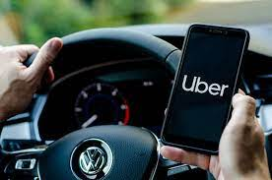

*NMTEAM ID: NM2023TMID13925
TEAM MEMBERS
TAMILARASAN.M
VELU.M
SATHISH
SRIDHAR.P

Slide 3

Distribution
Under the guidance of
Dr.P.PUVIARASU , M.Sc.,B.Ed.,M.Phil.,PGDCA.,Ph.,
Assistant professor
PG and Research Department of Mathematic
Government Thirumagal Mills college ,Gudiyattam- 632602

Slide 4
IN TRODUCTION
OVER VIEW
The ride-sharing business revolutionized a business model that had been functioning in the same way for generations: On a busy city street, a person in need of a ride stood on a street corner and waved down a taxi. On quieter streets, or in towns without roving taxis, the person would phone a local car service and request a pickup.

Slide 5
PURPOSE
Ride-sharing services like Uber have disrupted the taxi and limo industry,
Uber has become a prime example of the gig economy at work.
Uber's advantages include door-to-door convenience, safety, and reliable quality.
Uber's disadvantages include its surge pricing and the negative effects of replacing steady jobs with gig work.

Slide 6
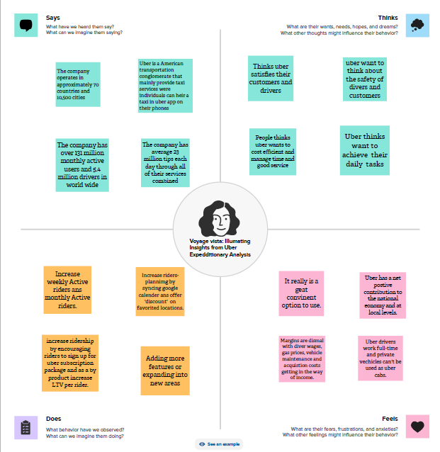
PROBLEM DEFINING &
DESIGN THINKING.
2.1 Empathy Map.

Slide 7
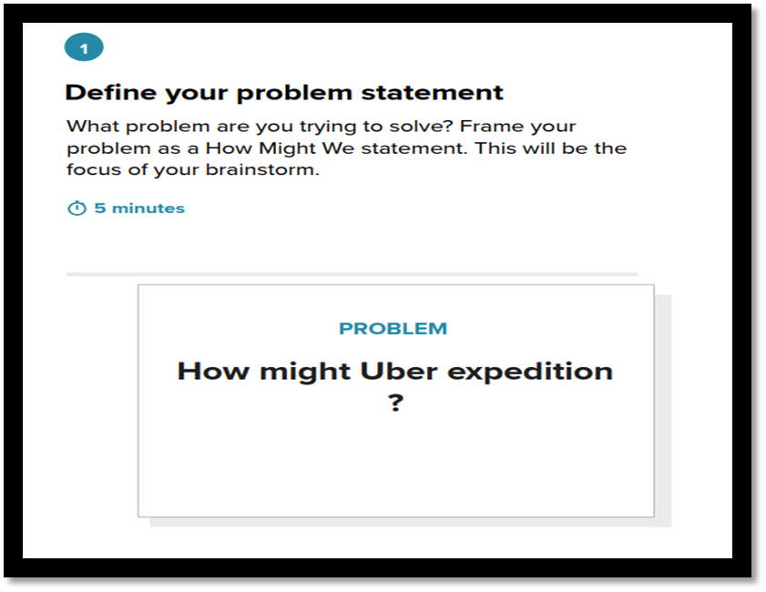

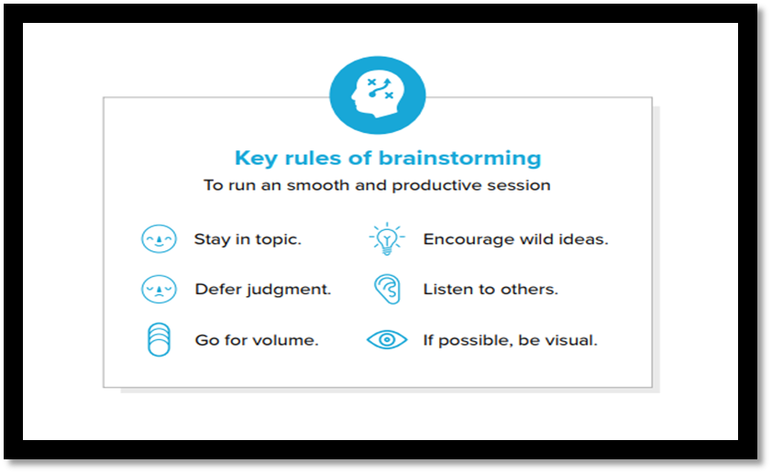
2.2 Ideation & Brainstorming Map.

Slide 8
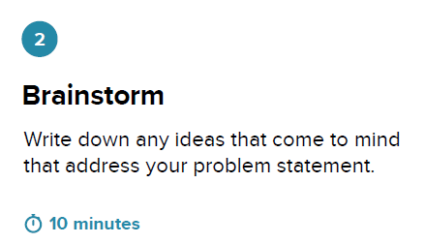
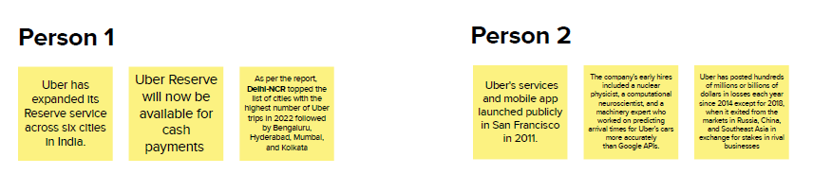
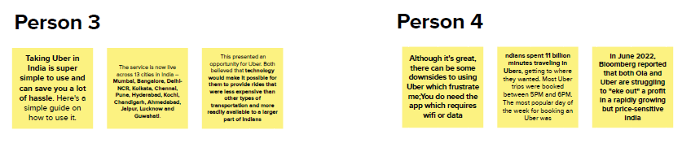

Slide 9
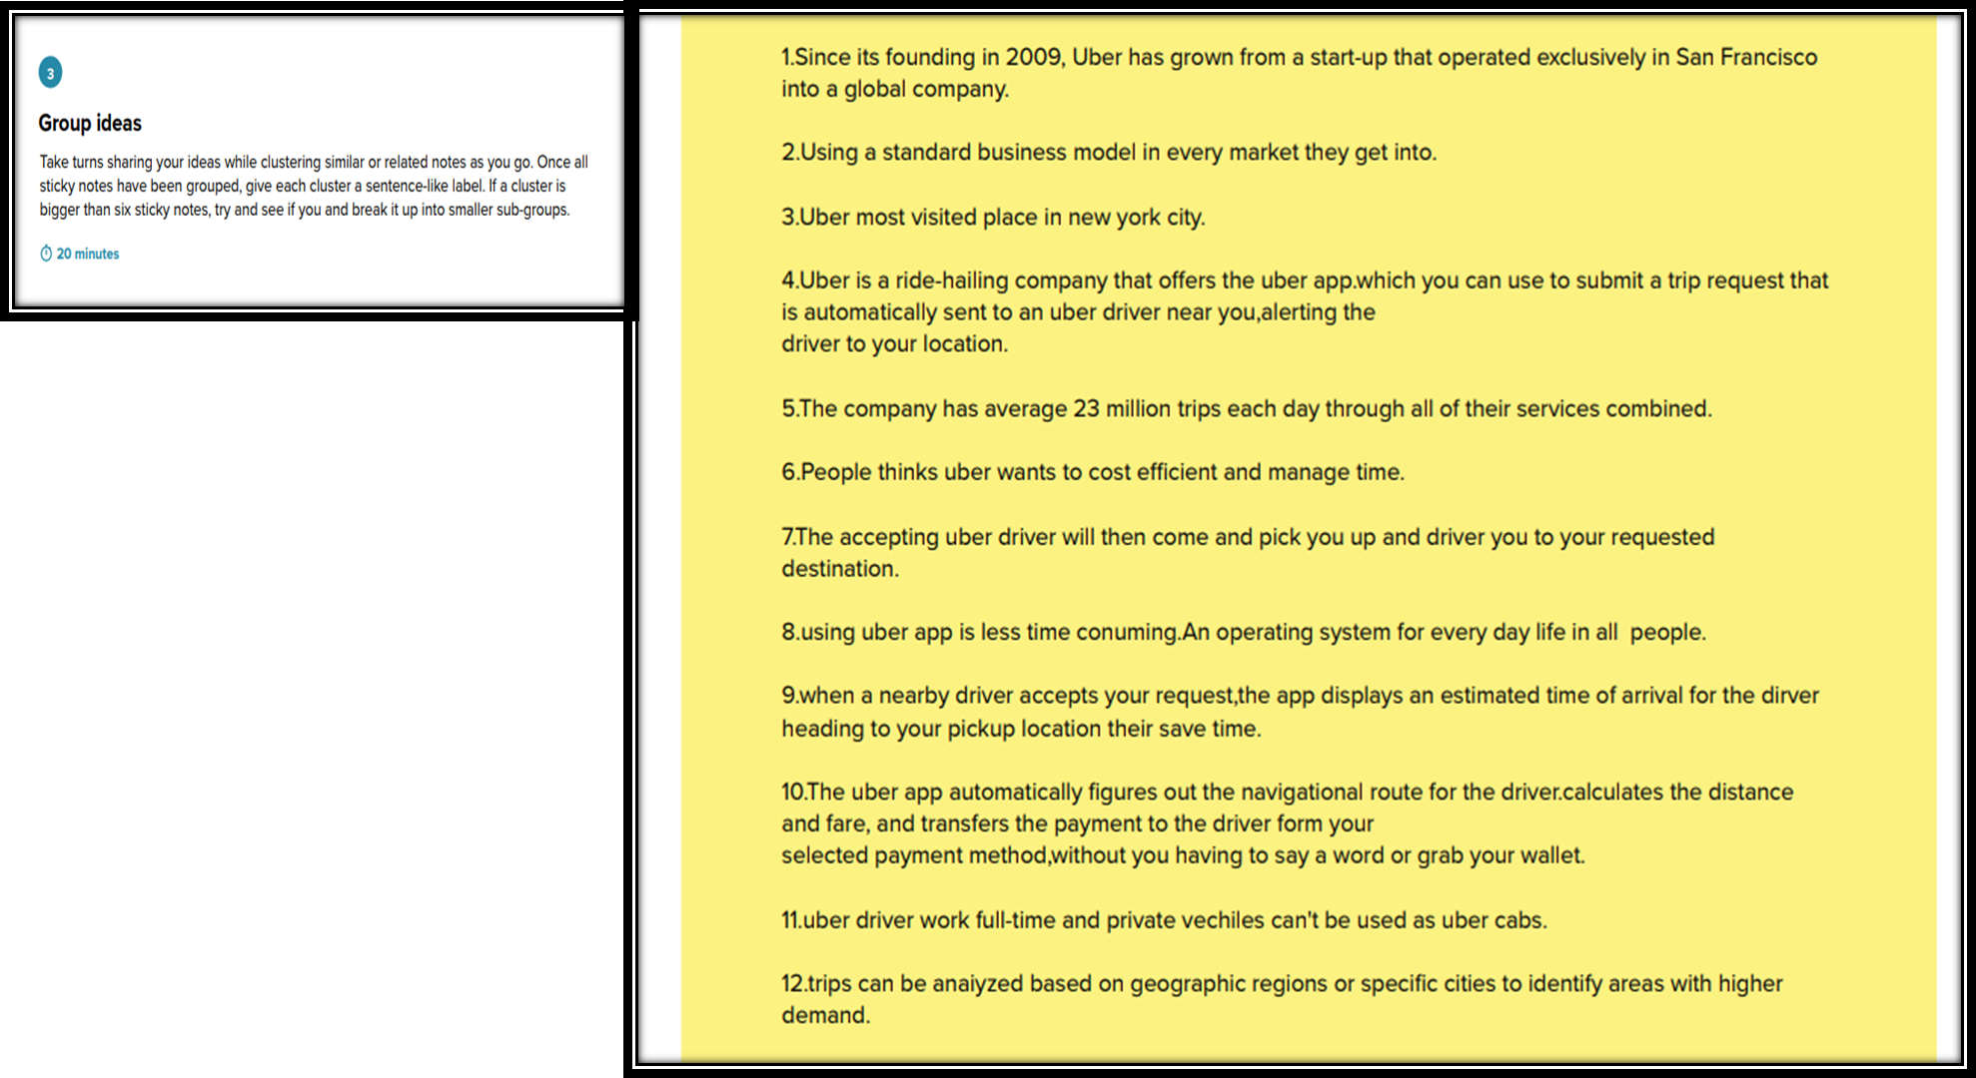

Slide 10
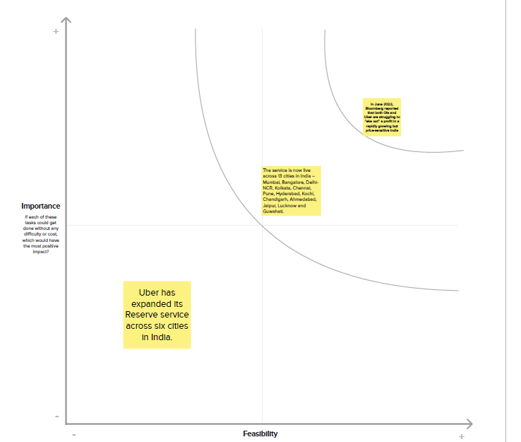

Slide 11
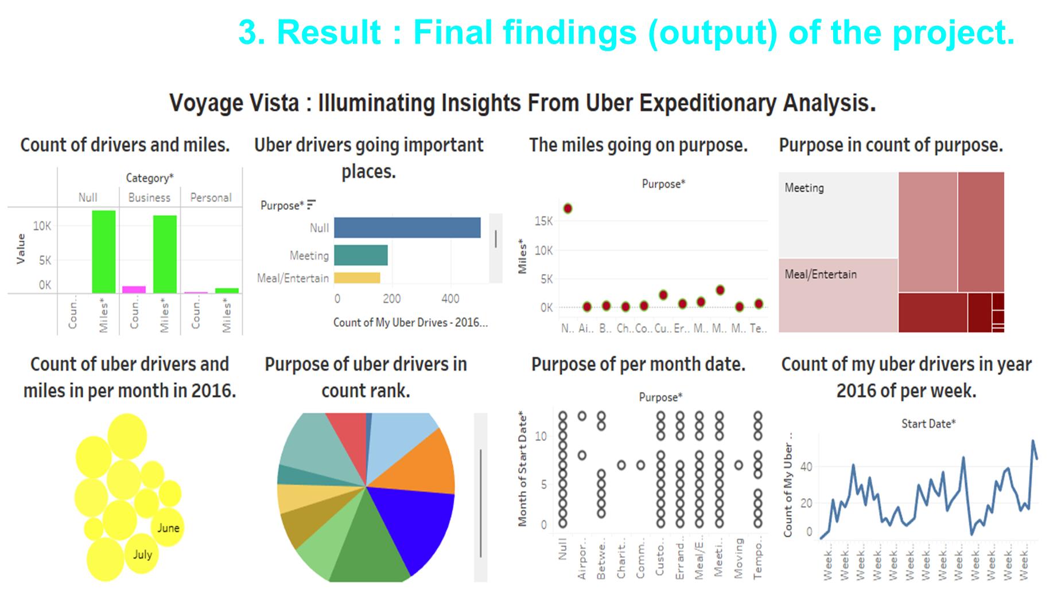

Slide 12
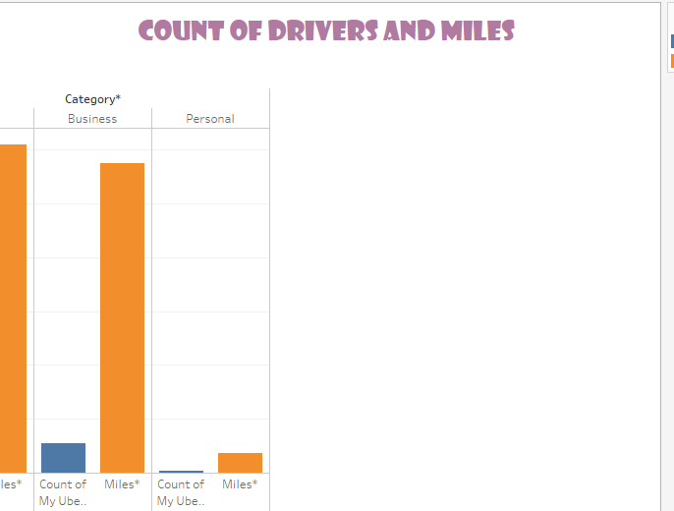

Story Visualization 1: Voyage Vista : Illuminating Insights From Uber Expeditionary Analysis.

Slide 13
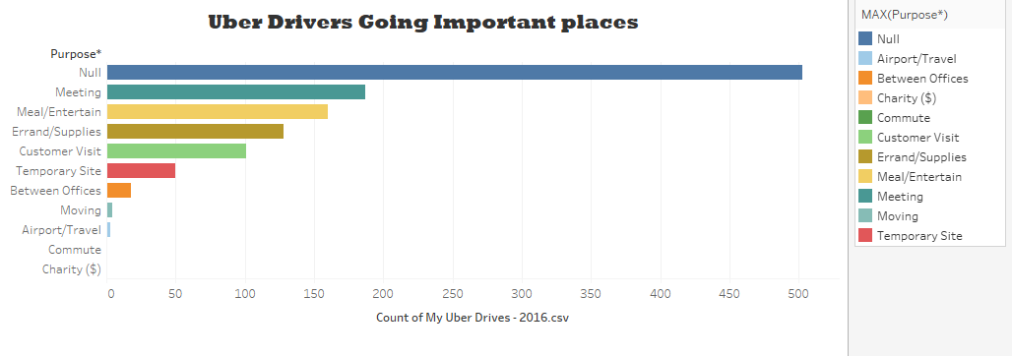

Slide 14
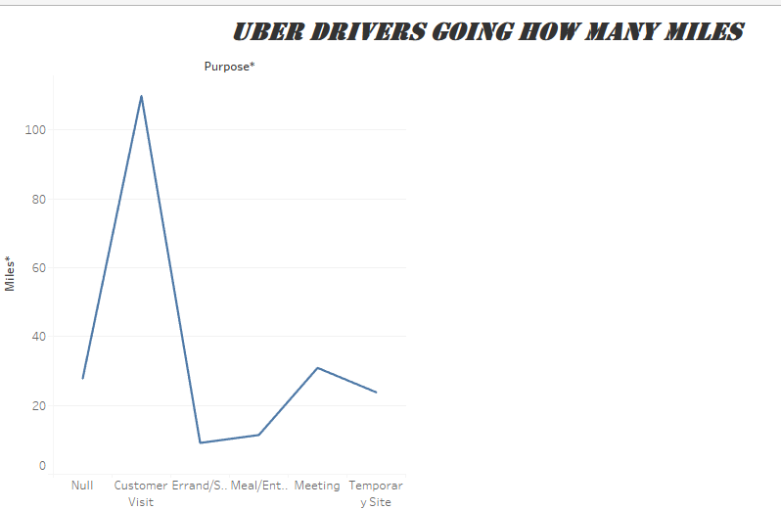
Story Visualization 3: Voyage Vista : Illuminating Insights From Uber Expeditionary Analysis.

Slide 15
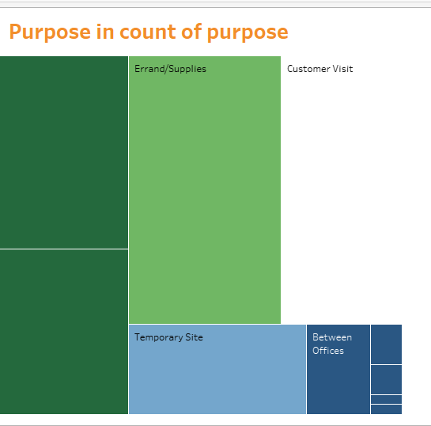
Story Visualization 4: Voyage Vista : Illuminating Insights From Uber Expeditionary Analysis.

Slide 16
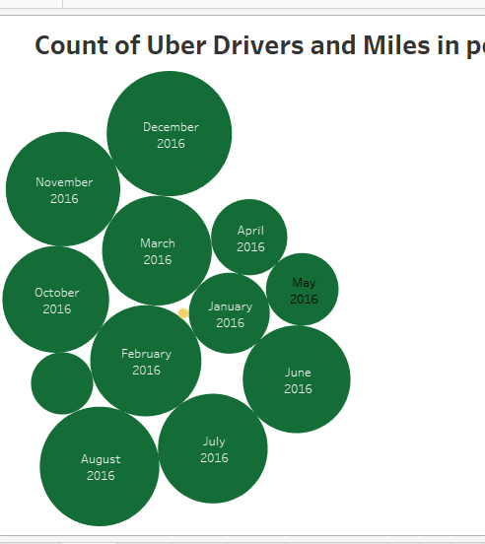
Story Visualization 5: Voyage Vista : Illuminating Insights From Uber Expeditionary Analysis.

Slide 17
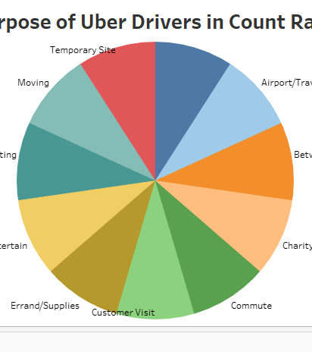
Story Visualization 6: Voyage Vista : Illuminating Insights From Uber Expeditionary Analysis.

Slide 18
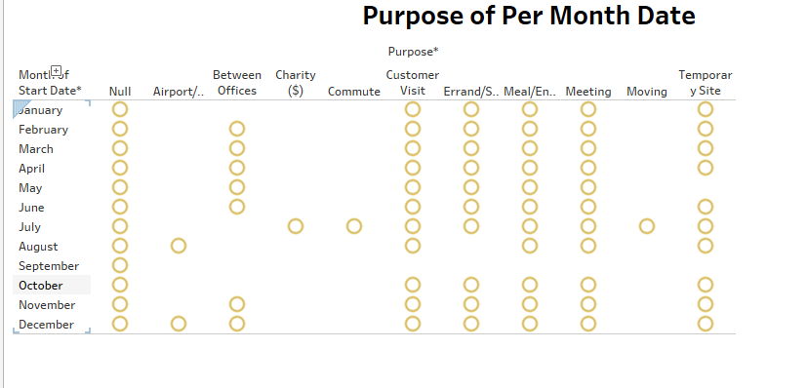
Story Visualization 7: Voyage Vista : Illuminating Insights From Uber Expeditionary Analysis.

Slide 19
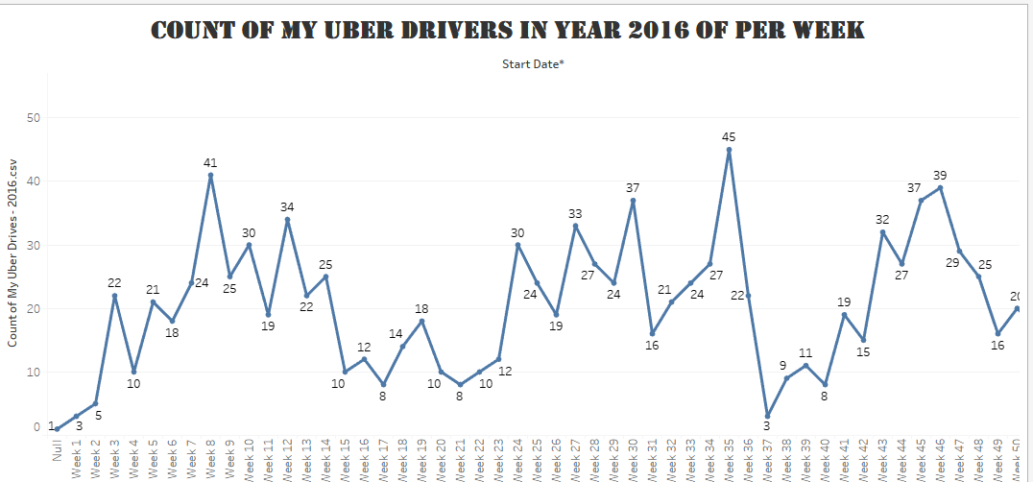
Story Visualization 8: Voyage Vista : Illuminating Insights From Uber Expeditionary Analysis.

Slide 20

4.ADVANTAGES AND DISADVANTAGES.
1.Uber's disadvantages include its surge pricing and the negative effects of replacing steady jobs with gig work.
2.Drivers are not assured of minimum pay to maintain their own vehicles. This topic is growing controversial in many cities because New York City mandated a $17.22 minimum wage for drivers.
3.The price model for Uber and other taxi apps can have higher booking prices due to busy times of the day.

Slide 21

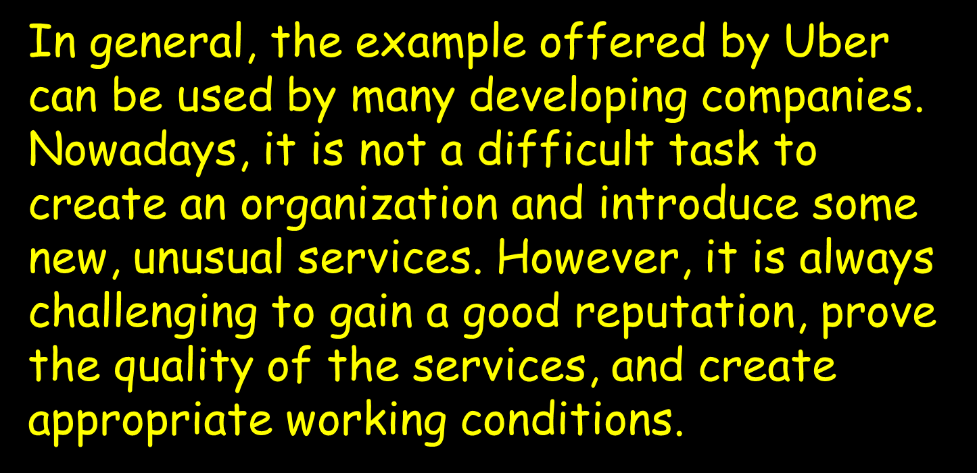

Slide 22
DASHBOARD LINK:: HTTPS://PUBLIC.TABLEAU.COM/VIEWS/ILLUMINATINGINSIGHTSFROMUBEREXPEDITIONARYANALYSIS_16972180841290/DASHBOARD2?:LANGUAGE=EN-US&PUBLISH=YES&:DISPLAY_COUNT=N&:ORIGIN=VIZ_SHARE_LINK
STORY LINKhttps: https://public.tableau.com/views/IlluminatingInsightsFromUberExpeditionaryAnalysis_16972180841290/Story1?:language=en-US&publish=yes&:display_count=n&:origin=viz_share_link

Slide 23
